Slide 1


IOT FARMING
Team Members:
Project Supervisor:
Berk Özdoruk Erdoğan Yağız Şahin Ömer Levent Durdalı
Oğuzhan Özkan
Dr. Cüneyt Sevgi

Slide 2
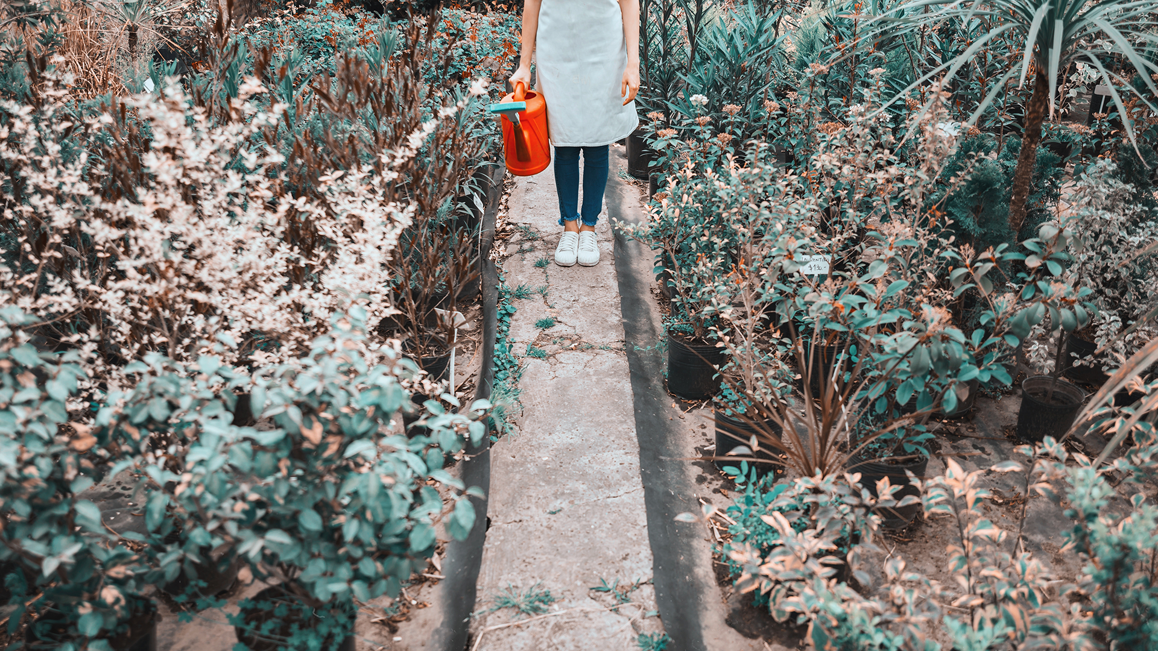
4. Test Scenario
1. About ELIXIR
2. Use Case Diagrams
3.Deployment Diagram
ROADMAP

Slide 3
What is ELIXIR?
Elixir is an automated smart irrigation and agriculture system designed to provide agricultural support and automate irrigation.
Agricultural support
Recommendations and Risks
Visualizations and Crop Infos
Remote and Smart Automatic Irrigation

Slide 4
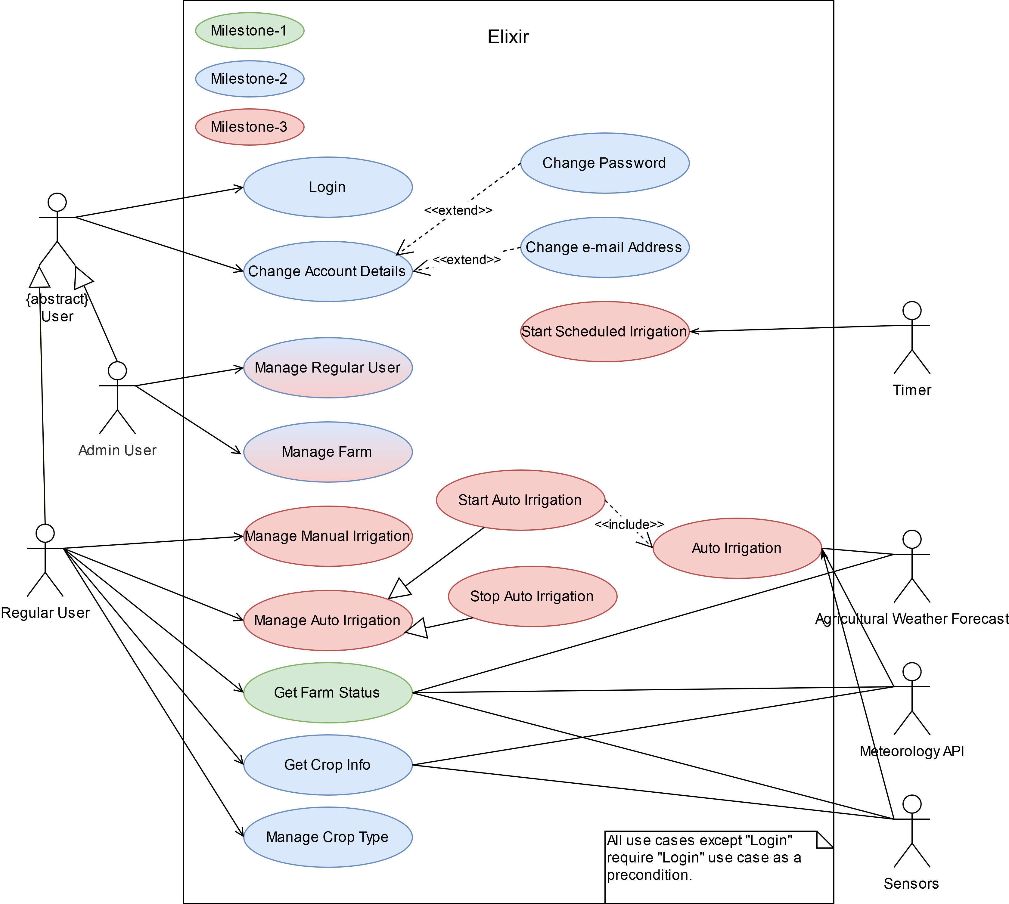
Use-Case
Diagram

Slide 5
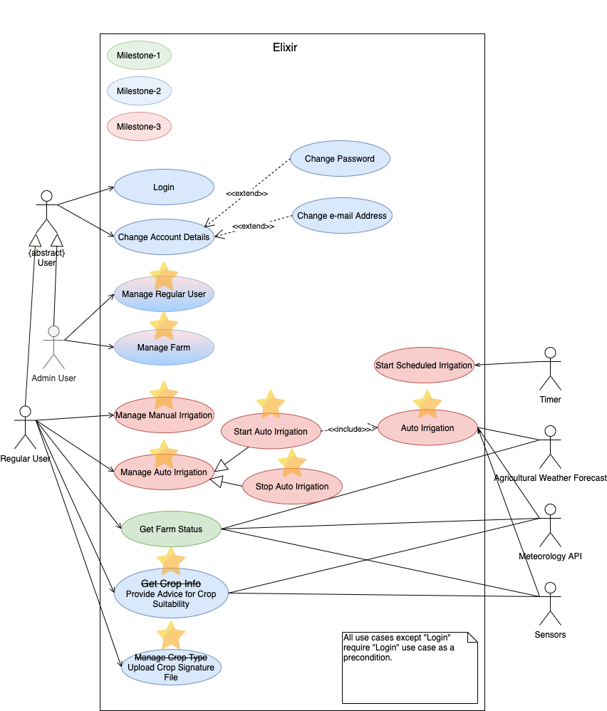
Use-Case
Diagram

Slide 6
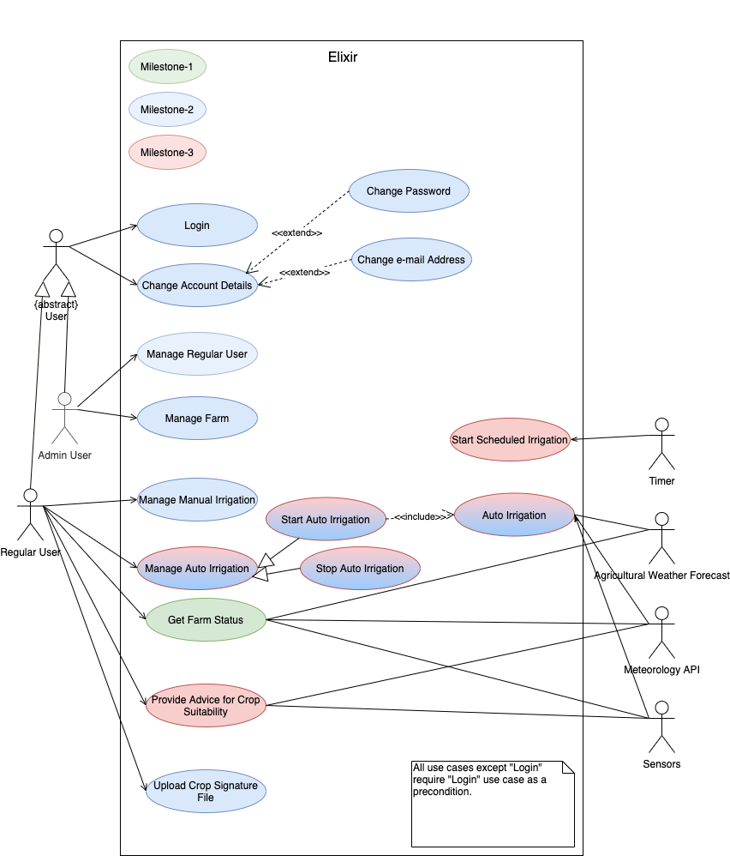
Use-Case
Diagram

Slide 7
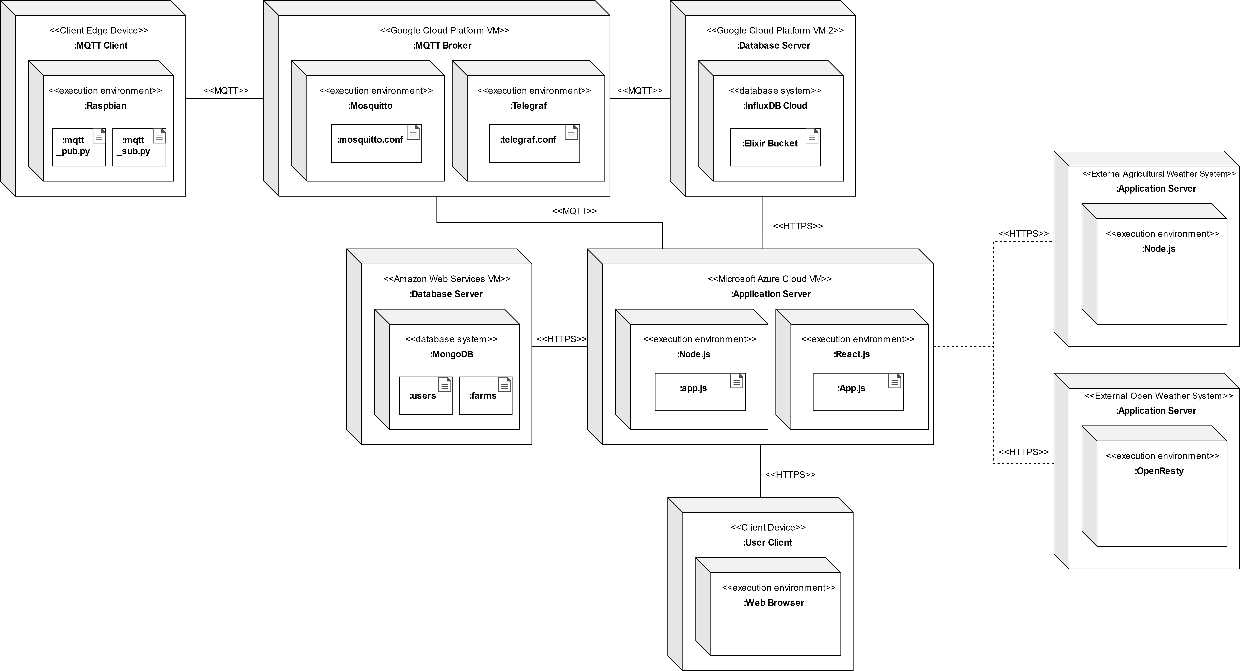
Deployment
Diagram

Slide 8
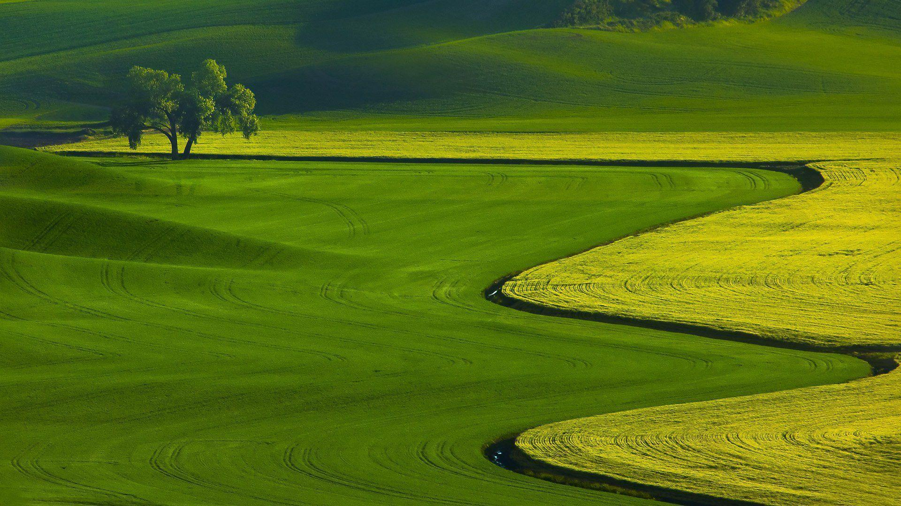

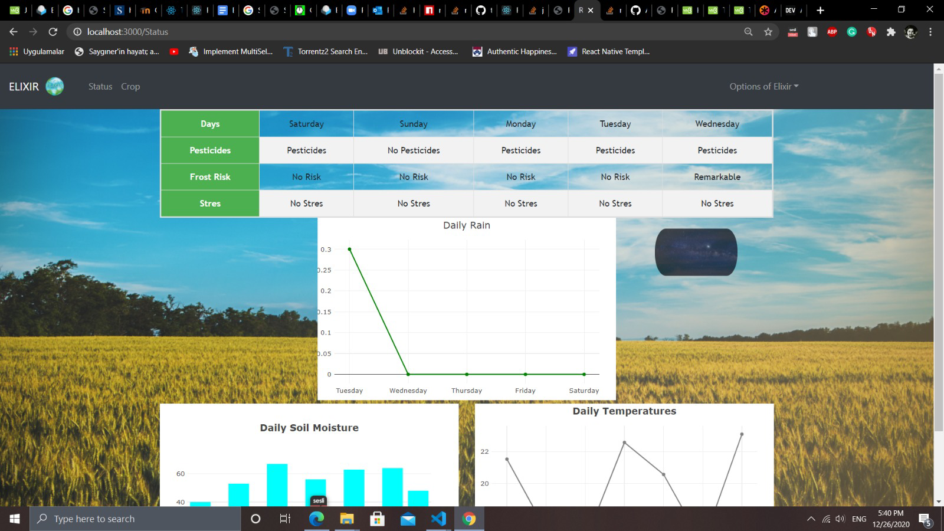
Test Scenario
and
Demonstration
Thank you for listening!

